Slide 1
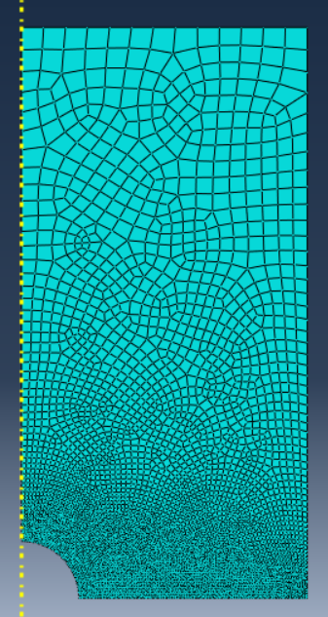
Analysis of Stress Concentration in cylindrical body having a cavity
Presented by:
Nikhil Dewangan
(Self project)

Slide 2
CONTENTS
Problem Statement
Solution
FEM Process
Comparison
Conclusion
References

Slide 3
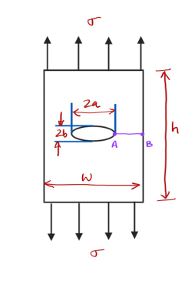
Problem Statement
A cylindrical solid with of height (h) and diameter (w=0.5 h) with an axisymmetric ellipsoidal cavity having major and minor axis of 2a and 2b lengths, respectively, at the center of the cylinder. a = 0.1w.
Consider b = a, a/2, a/6, a/10.
Compare stress concentration and stress distribution along line AB for different cases.

Slide 4
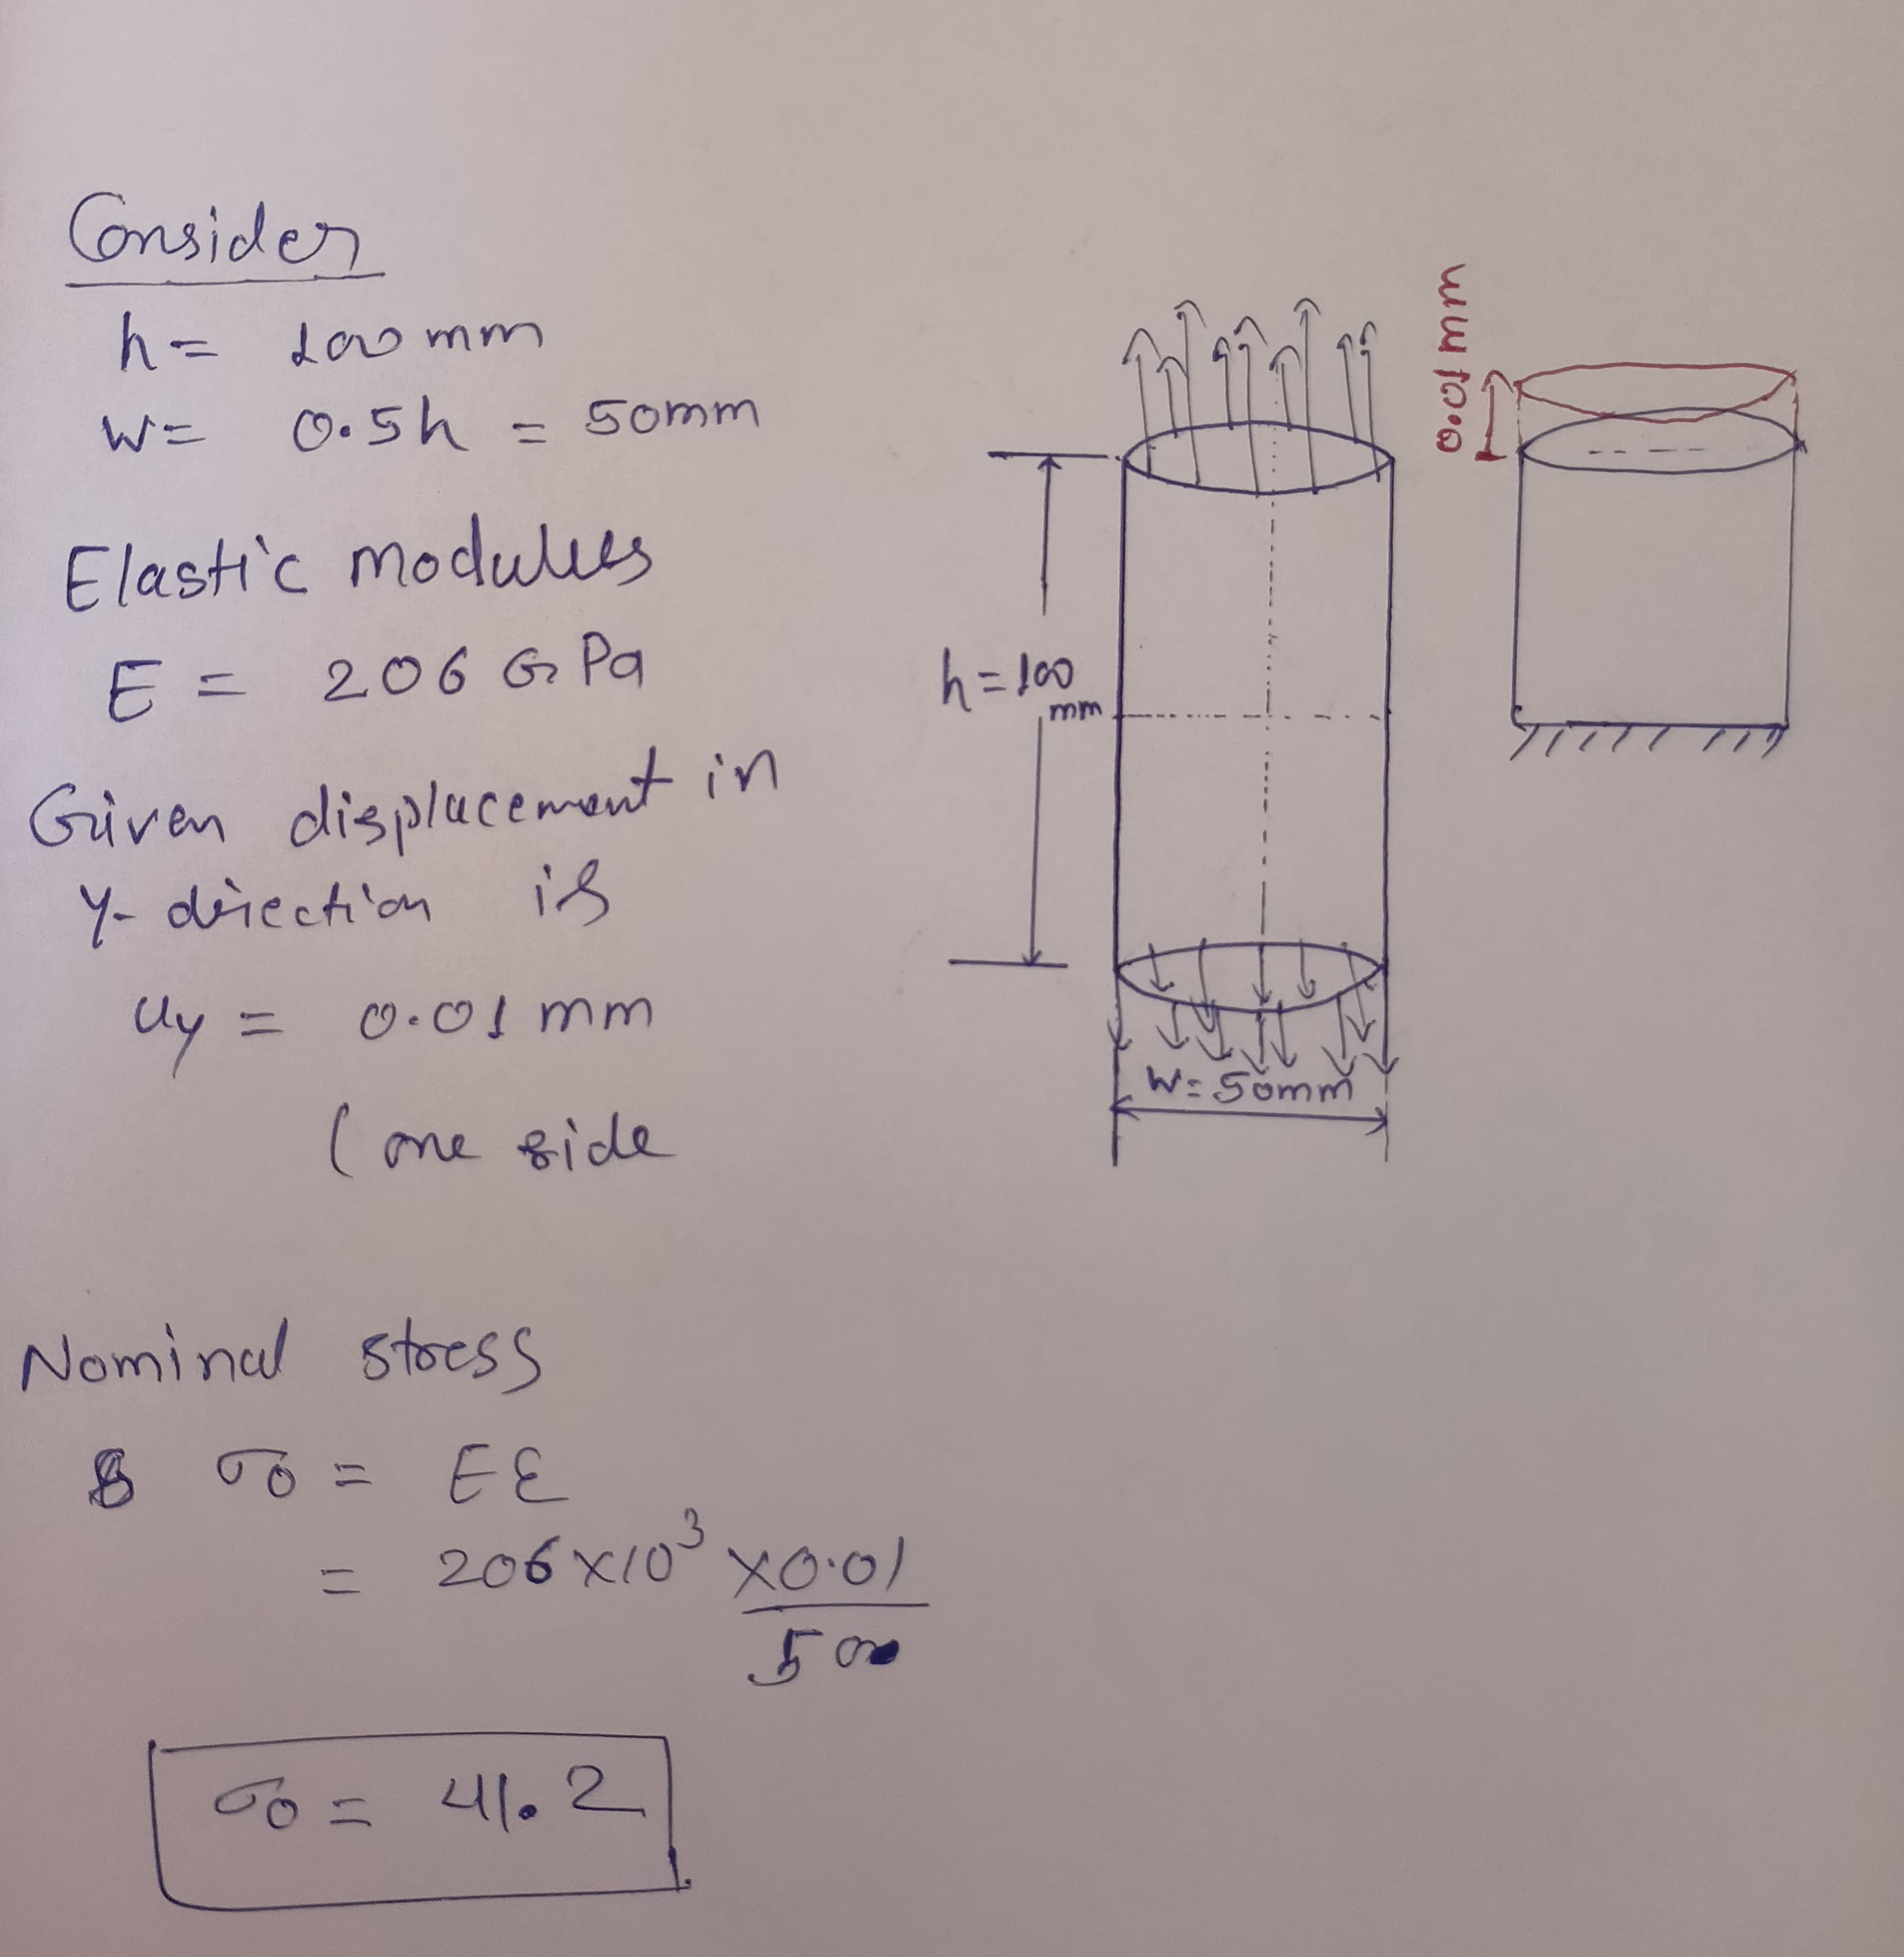
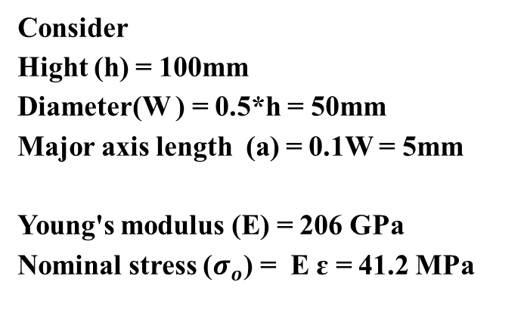
Solution
Consider
Hight (h) = 100mm
Diameter(W ) = 0.5*h = 50mm
Major axis length (a) = 0.1W = 5mm
Young's modulus (E) = 206 GPa
Nominal stress ($σ_{o}$) = E ɛ = 41.2 MPa
Cases | Condition | Stress concentration factor
A | a / b = 1 | 2.046
B | a / b = 2 | 3.313
C | a / b = 6 | 11.817 ( by linear interpolation between Case B and D)
D | a / b = 10 | 13.52

Slide 5
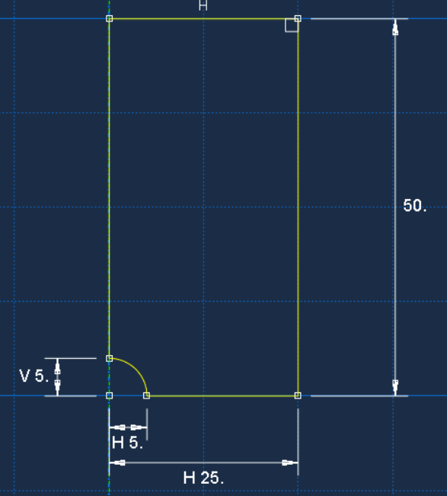
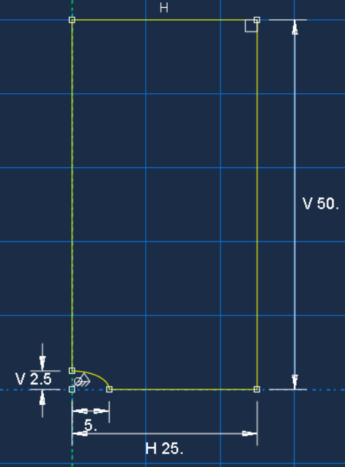
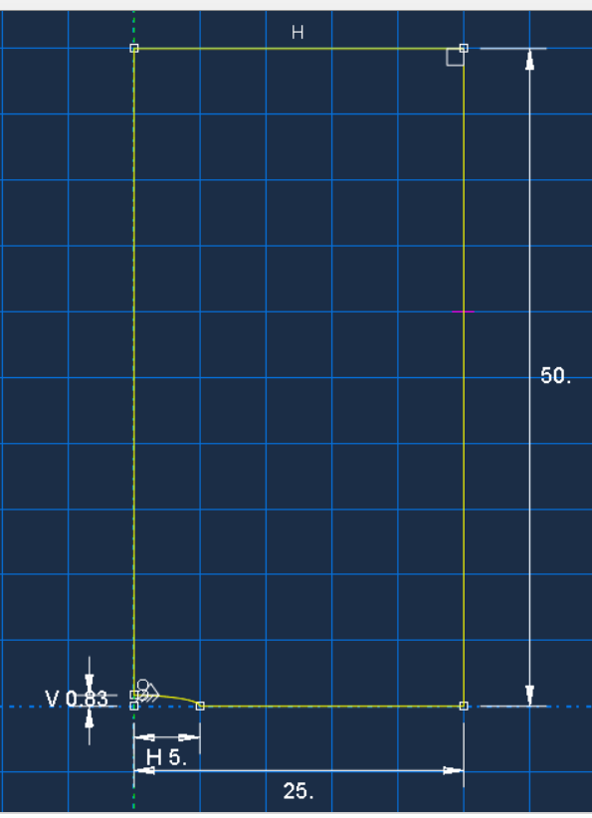
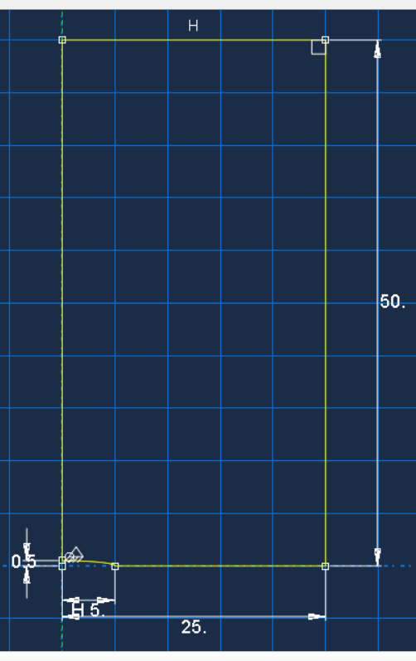
Creation of Part

Slide 6
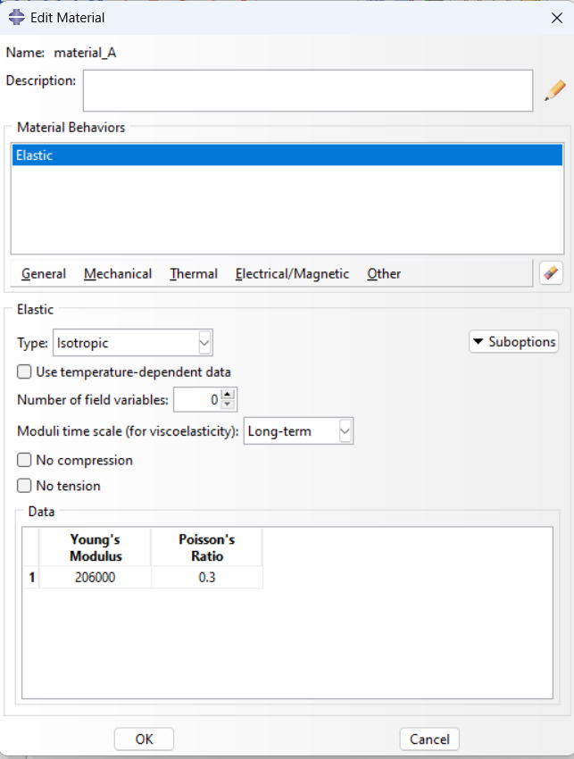
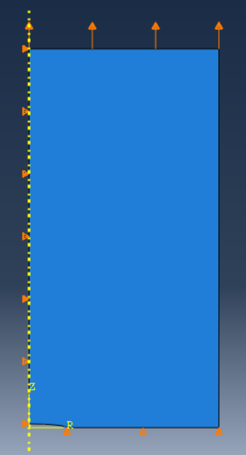
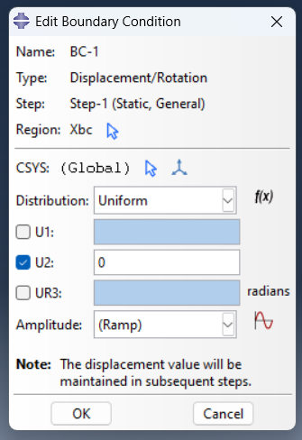
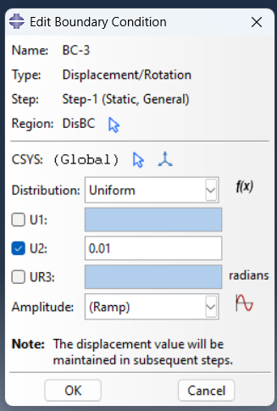
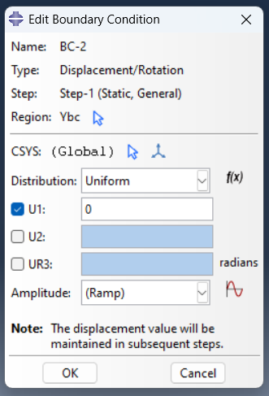
Assigning material properties & Boundary Condition

Slide 7
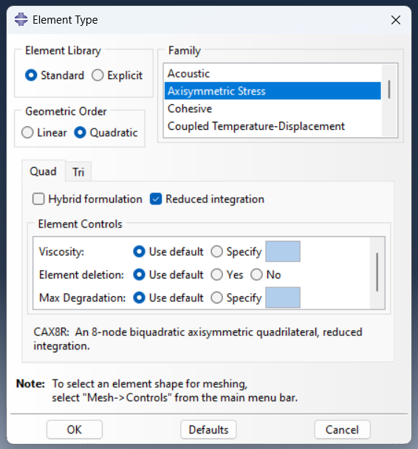
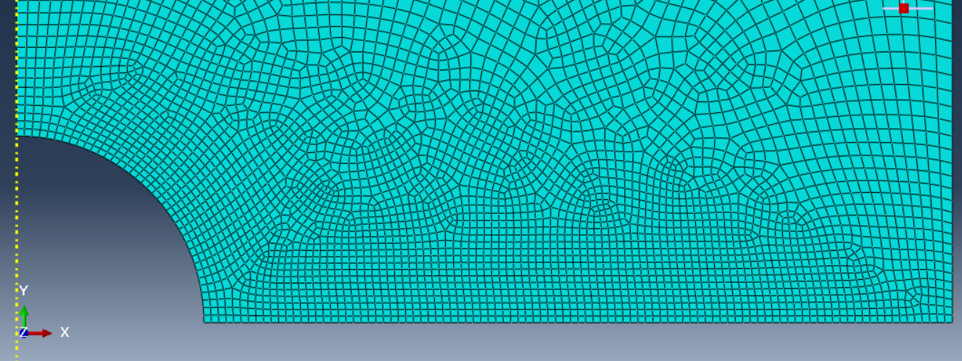
Meshing

Slide 8
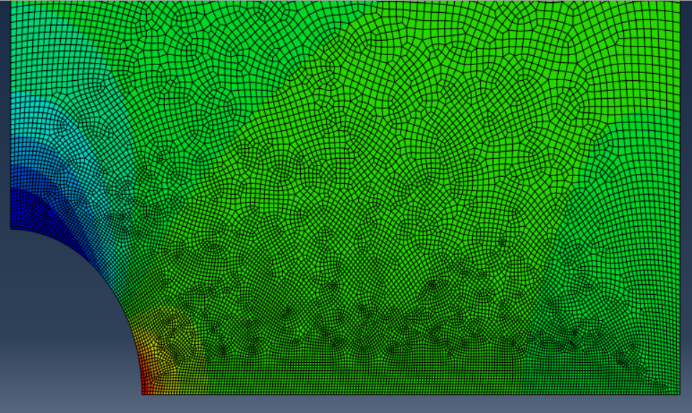
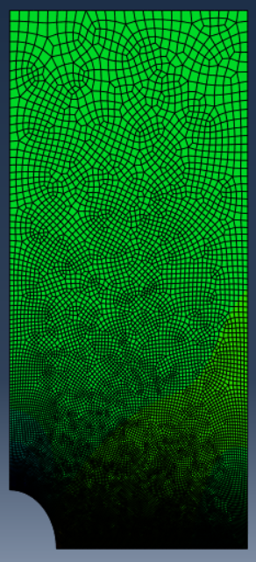
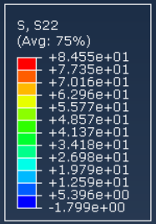
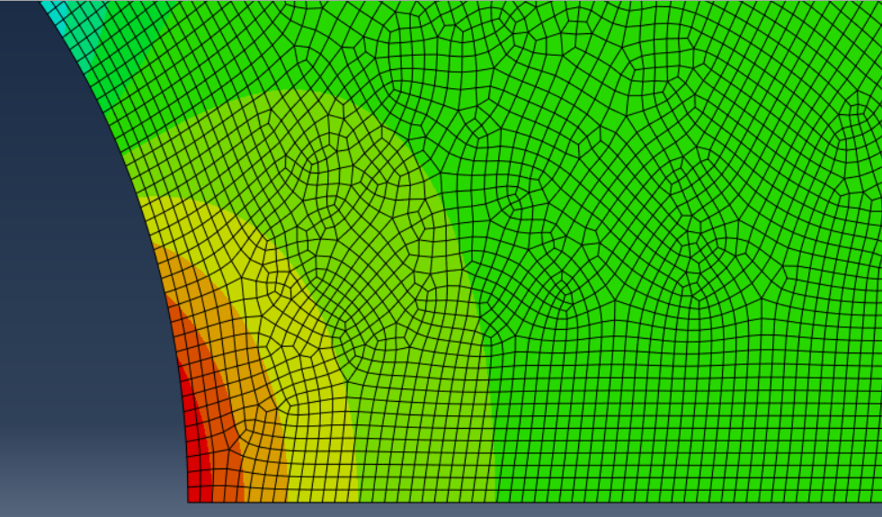
Result in case A (b = a)
Stress at point A = 84.547 MPa
Stress at point B = 40.752 MPa
SCF (K) = 2.0521

Slide 9
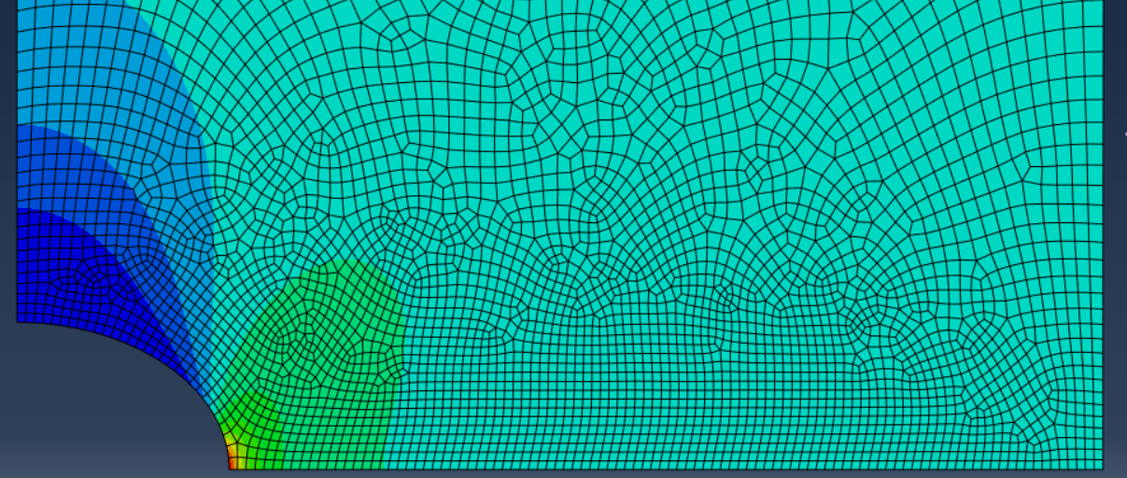
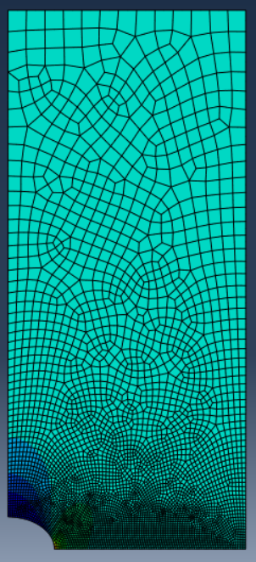
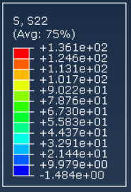
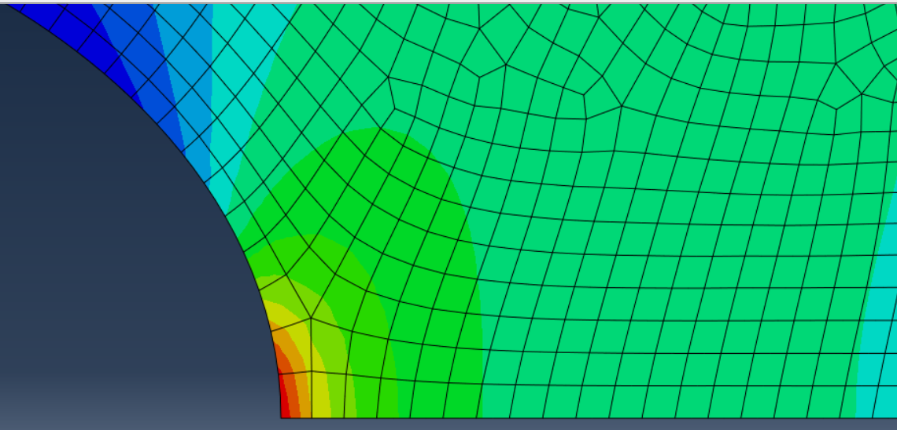
Result in case B (b = a/2)
Stress at point A = 136.076 MPa
Stress at point B = 40.901 MPa
SCF (K) = 3.3028

Slide 10
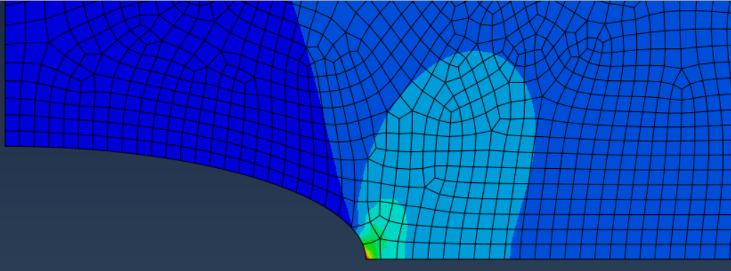
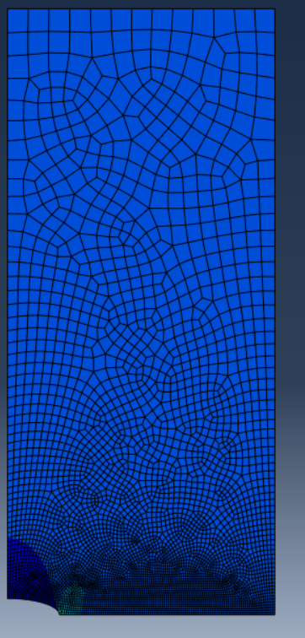
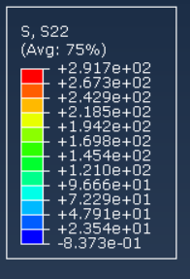
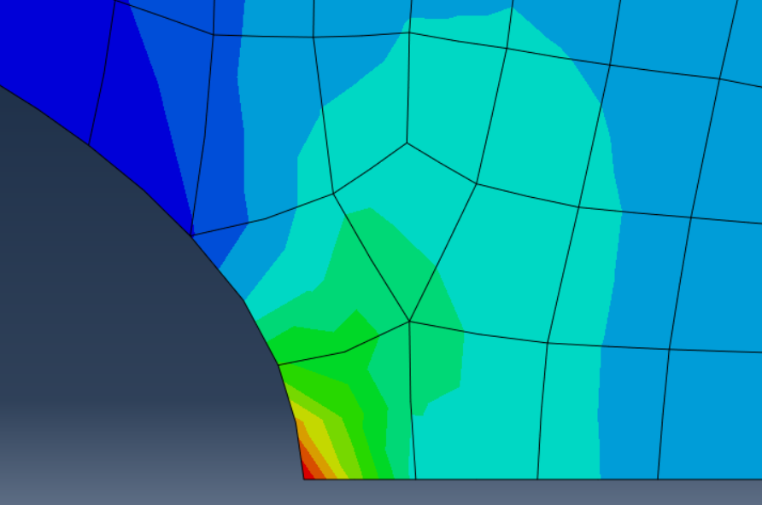
Result in Case C (b = a/6)
Stress at point A = 291.654 MPa
Stress at point B = 41.0425 MPa
SCF (K) = 7.0789

Slide 11
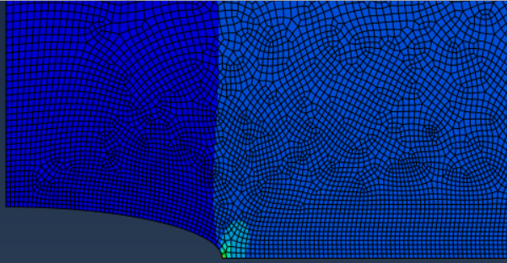
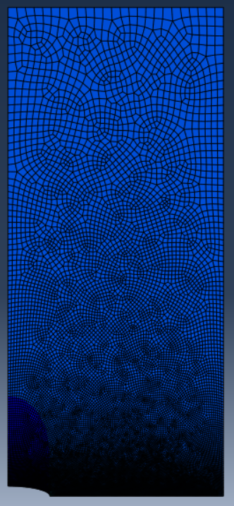
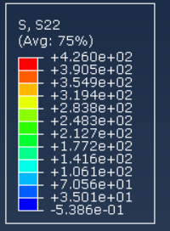
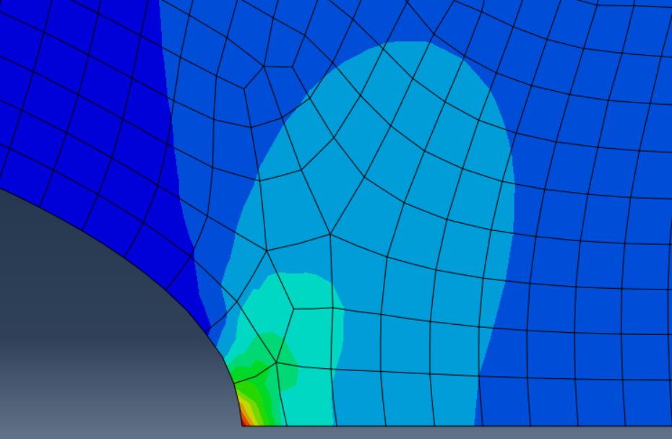
Result in Case D (b = a/10)
Stress at point A = 428.19 MPa
Stress at point B = 41.074 MPa
SCF (K) = 10.3929

Slide 12
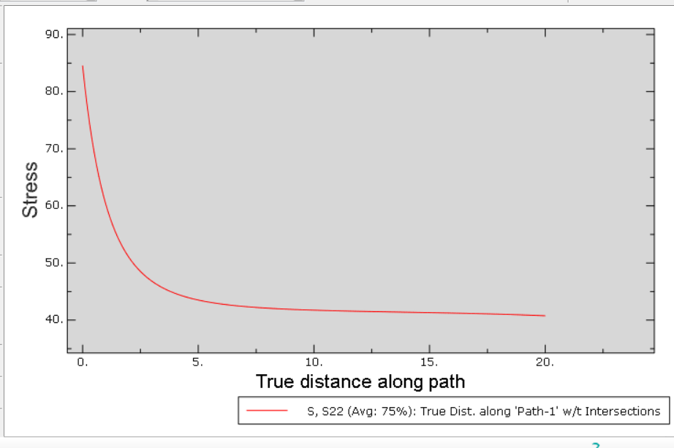
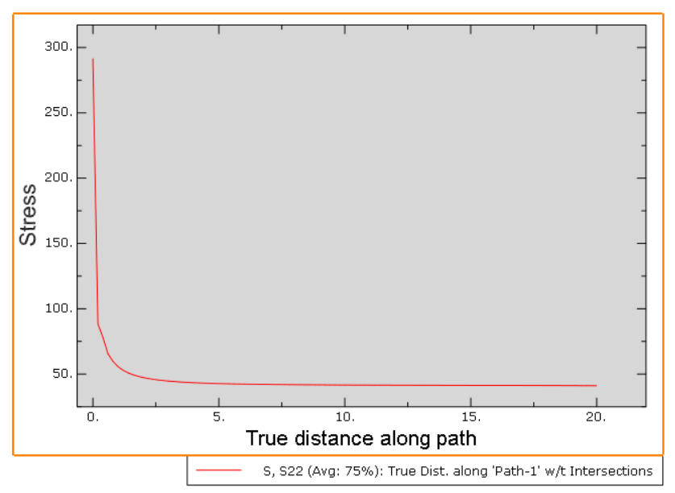
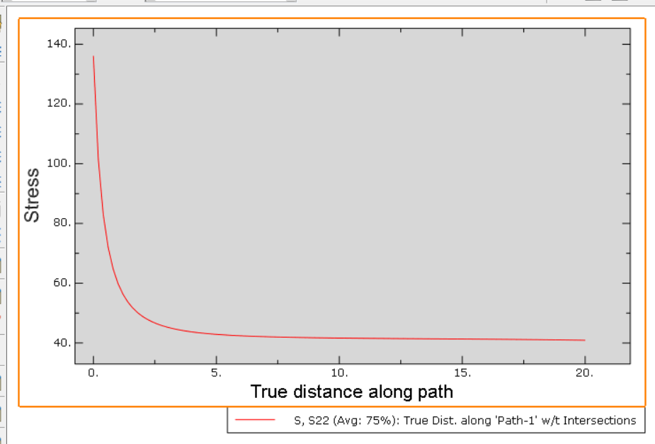
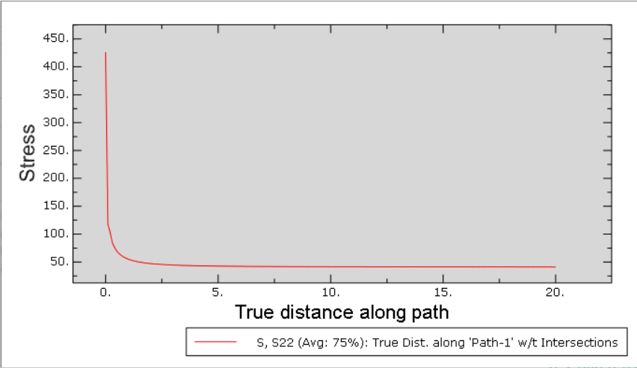
Graph of all cases
Case A
case C
case B
Case D

Slide 13
Combine graph
Stress in MPa
Normalized distance

Slide 14
Comparison
Sr. No | Cases | SCF by FEM | Actual SCF | Error in %
A | b = a | 2.0521 | 2.045 | 0.3471
B | b = a / 2 | 3.3028 | 3.313 | 0.3078
C | b = a / 6 | 7.0789 | 11.817 | 40.09
D | b = a / 10 | 10.3929 | 13.520 | 23.12

Slide 15
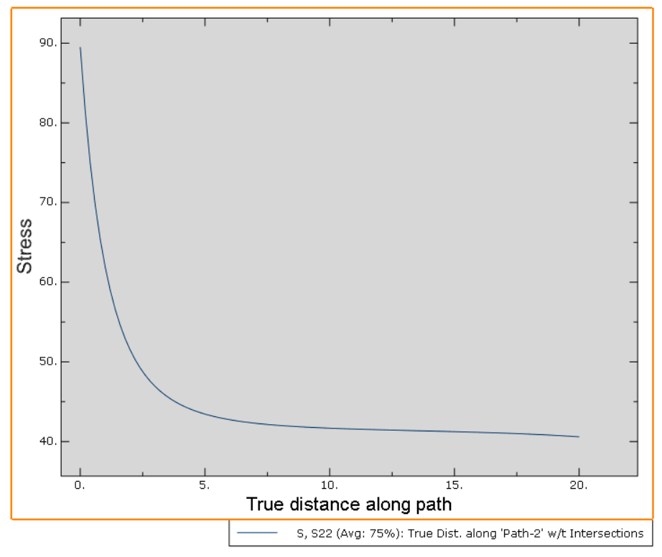
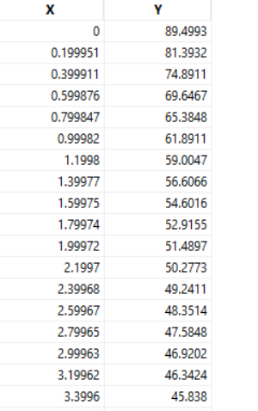
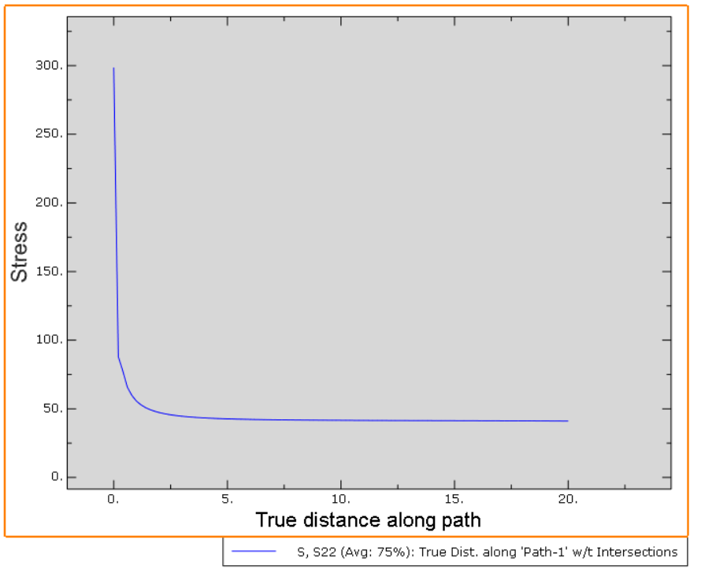
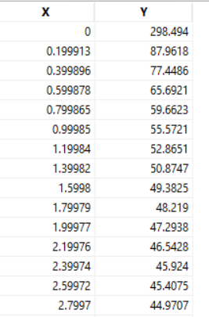
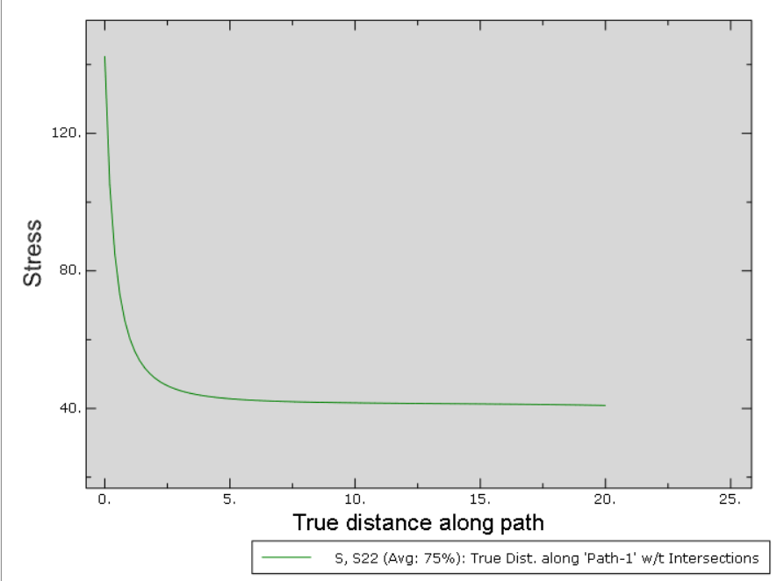
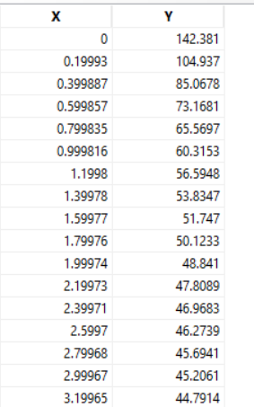
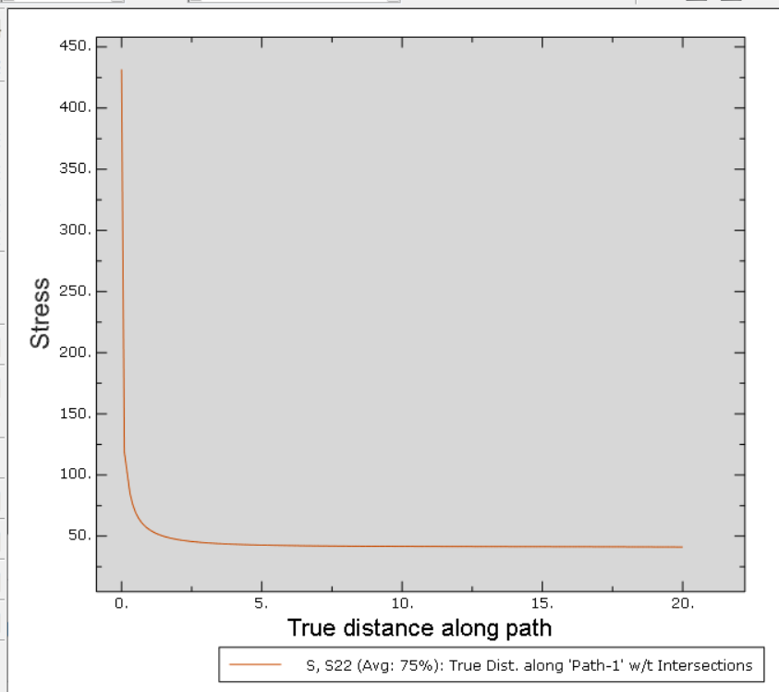
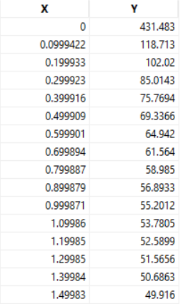
For Poisson’s ratio is 0.498
Case A
Case C
Case B
Case D

Slide 16
Conclusion
SCF increases with decrease in ratio of b/a
SCF is minimum when ratio of b/a is 1

Slide 17
References
Theory of elasticity and stress concentration by Yukitaka Murakami

Slide 18
Thank you

